Slide 1
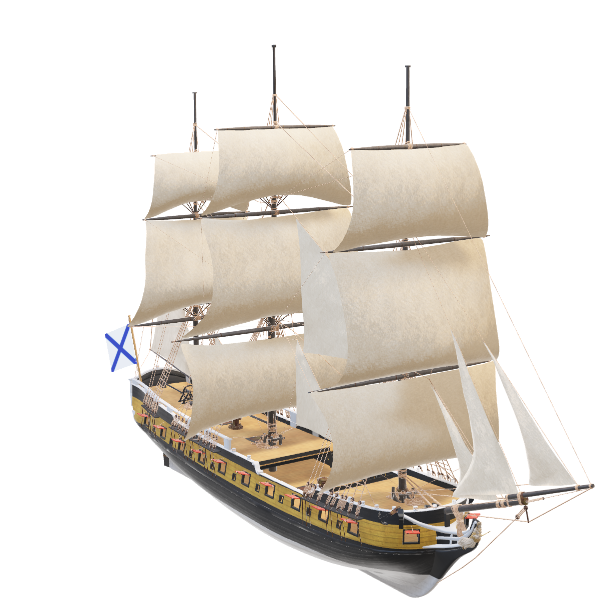
CELEBRATING GLOBAL TRADE
A
HUMAN-AI
Collaboration Project
Exploring a
17th CENTURY ATLAS

Slide 2
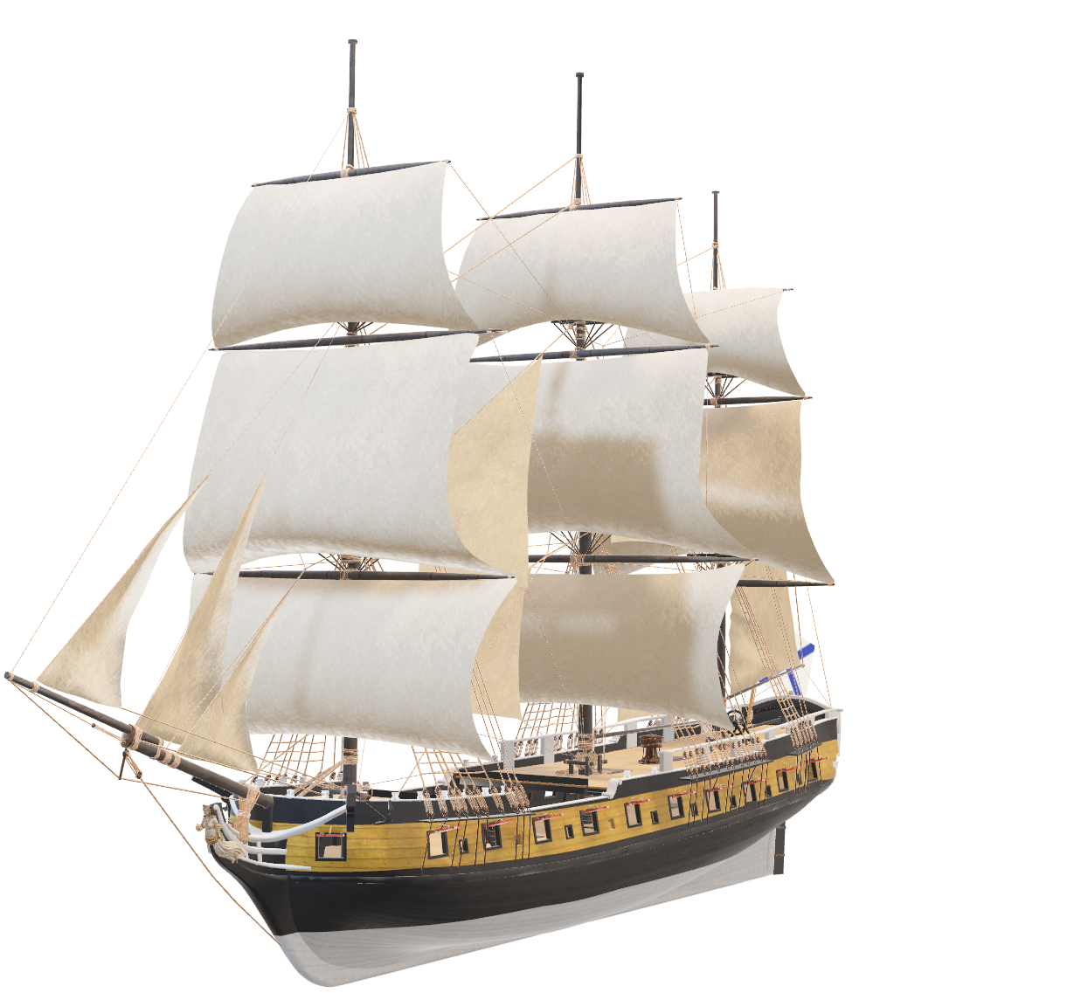
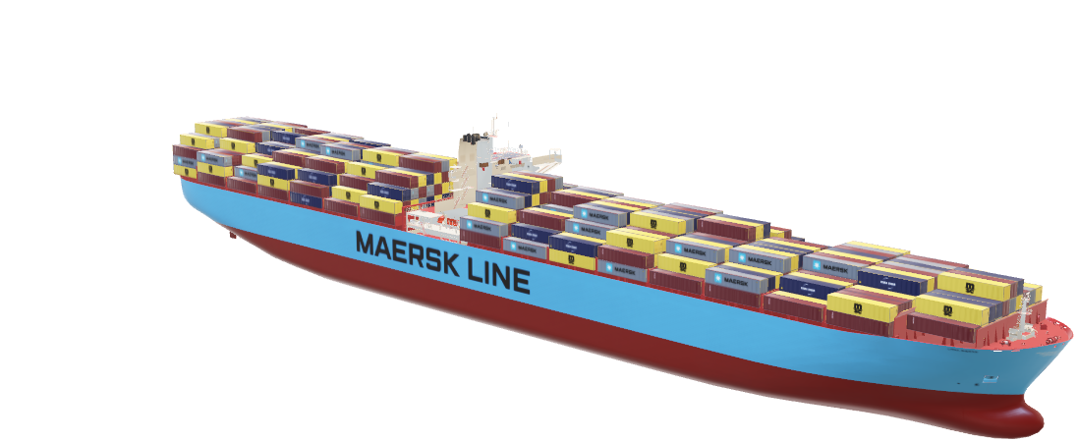
17th CENTURY ATLAS
A
GEOGRAPHICAL DESCRIPTION
Of the Four Parts of the
By Richard Blome
WORLD
1600s Maps
Country Information
Merchant Invoices

Slide 3
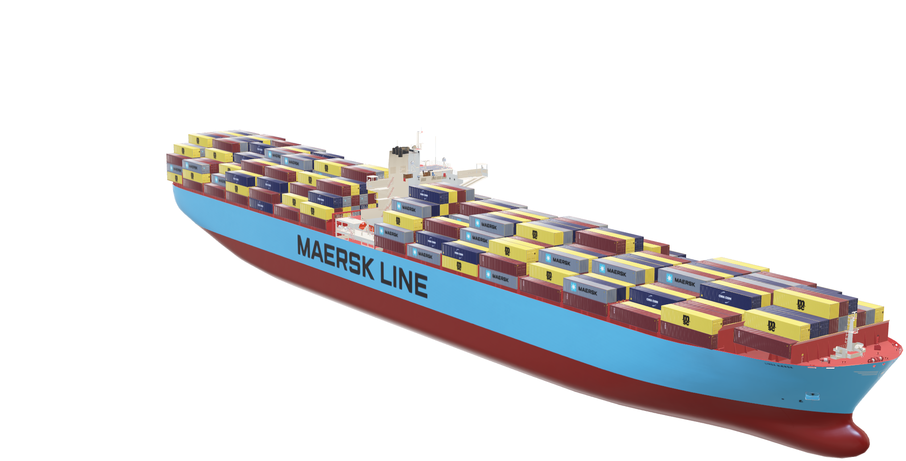

MODERN
Extraordinary variety of goods sourced from all over the planet at affordable prices. The project will engage the public through critical exploration of this , social and cultural topic.
A
GEOGRAPHICAL DESCRIPTION
Of the Four Parts of the WORLD
TRADE
WORLD
Technical
2015 Globalisation Backlash
2021 Suez Canal Obstruction
2023 Red Sea Shipping Crisis

Slide 4
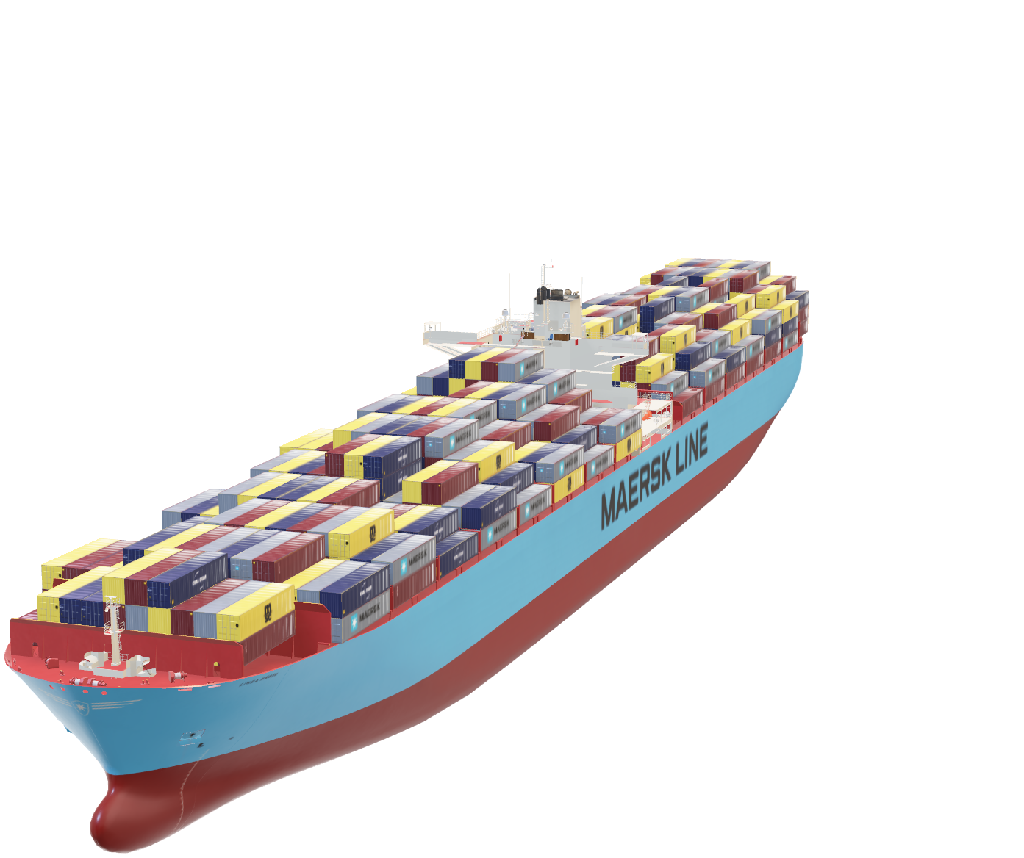
Technical
AI and Human Creative Process
HUMAN
Jupyter notebook
Text, images, video and code
Articles
AI
Text generation
- digitised text from atlas
Image generation
- new maps in style of atlas

